Slide 1
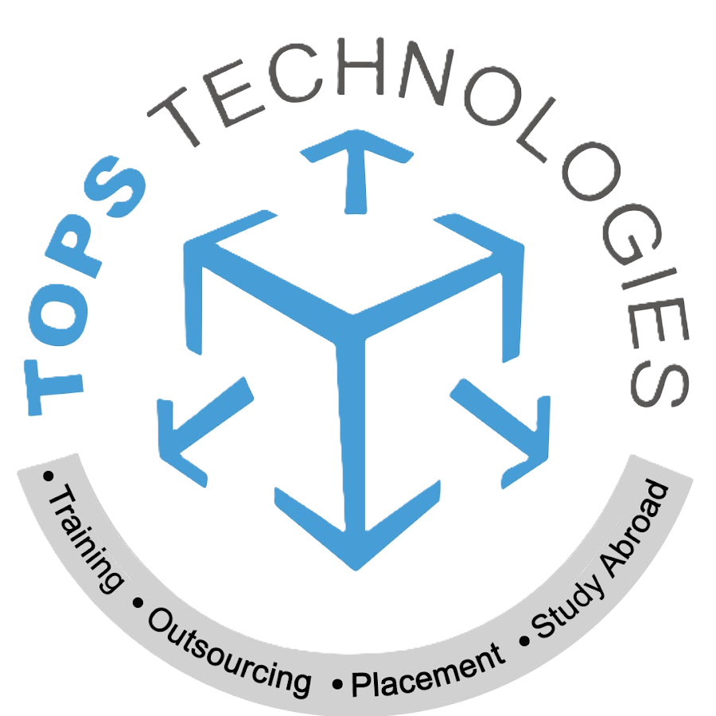
How Regression Models are used in Business
TOPS TECHNOLOGIES
Submitted by:- Ruchit Thummar

Slide 2
OUTLINE
What Is a Regression Model?
Why Businesses Use Regression
How Regression Helps With Decision Making
Common Types of Regression
Example in Marketing & Finance
Benefits of Regression Models
Conclusion

Slide 3
What is Regression Model?
Regression model is a statistical method used to find relationships between variables.
It helps us understand how one factor affects another and allows us to make predictions based on data.
It helps find patterns in past data, shows how different variables are related, and allows us to predict future outcomes.
Example:
Company wants to know how advertising spending affects sales.
They look at past data and see that when they spend more money on ads, their sales usually increase.
Regression model creates a line that shows this pattern and helps the company predict how much money they might earn if they increase or decrease advertising in the future.

Slide 4
Why Businesses Use Regression Models
Regression models are useful in business because they help leaders make smarter decisions using data instead of guessing.
Businesses use regression to predict future trends such as sales, customer demand, or buying behavior, so they can prepare and plan ahead.
Regression models also helps companies understand which factors have the biggest effect on results, such as price, location, or advertising efforts.
It allows businesses to test ideas before spending money, for example changing the product price or increasing marketing, to see how those changes might affect performance.
Regression models helps reduce risk because decisions are based on real numbers and data patterns rather than guesses or assumptions.

Slide 5
How Regression Helps With Decision Making
Regression turns raw data into useful insights, which helps businesses make decisions based on facts rather than personal opinions.
It also makes planning more accurate because it shows what is likely to happen in the future based on past patterns and relationships.
Regression allows companies to compare different options and choose the one that is expected to deliver the best results, such as comparing pricing strategies or product features.
It helps test ideas before spending money, for example changing prices or increasing marketing, so businesses can estimate the outcome before acting.
Regression reduces uncertainty and risk by clearly showing how different actions affect results, which helps companies avoid costly mistakes.

Slide 6
Types of Regression Models Used in Business
1. Linear Regression
This model shows a simple straight-line relationship between two variables. It is used when one factor affects another in a predictable way.
Example: A company uses linear regression to see how changes in product price affect sales numbers.
2. Logistic Regression
This model is used when the outcome is a yes or no result. Instead of predicting a number, it predicts the probability of an event happening.
Example: A bank uses logistic regression to predict whether a customer is likely to repay or default on a loan.

Slide 7
3. Polynomial Regression
This model is used when the relationship between variables is curved rather than a straight line. It helps when data doesn’t follow a simple pattern.
Example: A retail company uses polynomial regression to analyze how customer satisfaction changes at different discount levels, where small or very large discounts may affect satisfaction differently.
4. Ridge Regression
This model is useful when there are many variables that may cause overfitting. Ridge regression helps control noise and makes the model more stable.
Example: A marketing team uses ridge regression to analyze hundreds of customer behavior features to predict who is most likely to respond to a promotion.

Slide 8
5. Lasso Regression
This model helps find the most important factors by reducing or removing variables that do not strongly affect the outcome. It improves model simplicity and accuracy.
Example: A company analyzing employee performance uses lasso regression to identify which factors training hours, experience, education, or job role matter the most.
6. Decision Tree Regressor
This model makes predictions by splitting data into branches based on rules. It is easy to understand because it works like a flowchart.
Example: A company uses a decision tree to predict house prices based on factors like location, size, and number of rooms.

Slide 9
7. Random Forest Regressor
This model is made of many decision trees working together. It combines their results to make more accurate and stable predictions than a single tree.
Example: An e-commerce company uses a random forest regressor to predict customer spending based on age, income, browsing history, and purchase behavior.
8. Support Vector Machine (SVM) Regressor
This model finds the best possible line or curve that fits the data. It works well when data is complex and not easily separated.
Example: A telecom company uses an SVM regressor to predict internet usage patterns so they can improve network performance and customer experience.

Slide 10
Example in Marketing & Finance
Marketing Example:
A business uses regression to study how advertising spending affects sales.
By analyzing past data, they can see whether social media ads, TV ads, or online promotions create the most customer interest.
This helps the company decide where to invest their marketing budget for the best return.
Finance Example:
A bank uses regression to estimate whether a customer is likely to repay a loan.
The model analyzes past loan data and considers factors such as income, credit score, and employment history.
This allows the bank to approve loans more confidently and reduce financial risk.

Slide 11
Benefits of Regression Models
Regression models provide several important benefits for businesses. They help predict future outcomes such as sales, customer trends, or market demand, which allows companies to plan ahead with more confidence.
These models also make it easier to see which factors have the biggest impact on performance, so businesses can focus their time and money on what truly matters.
Regression supports smarter budgeting because it shows which decisions are likely to deliver the best results. It also helps reduce risk, since decisions are based on real data rather than assumptions or guesswork.
Regression allows businesses to test ideas and strategies before investing large amounts of money. regression models improve accuracy, reduce uncertainty, and support better decision making.

Slide 12
Conclusion
Regression models play an important role in helping businesses make smarter and more informed decisions. By analyzing past data, these models help companies understand relationships, identify what influences outcomes, and make accurate predictions about the future.
This leads to better planning, improved efficiency, and reduced risk. Whether used in marketing, finance, operations, or forecasting, regression models help organizations rely on data rather than guesswork. regression gives businesses clearer answers and supports stronger, more confident decision making.

Slide 13
THANK YOU

